Slide 1
Module 21

Slide 2
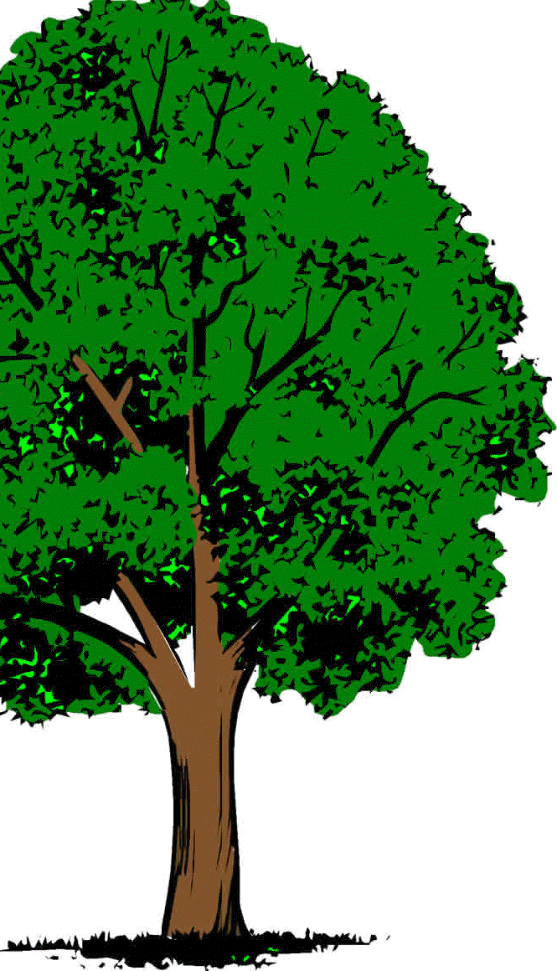

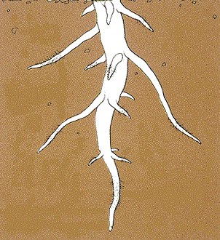
Root pressure is adequate to move water only in small plants like herbs and shrubs or small trees.
Then how is water transported in tall trees???
However it is not enough to move the water in tall trees.

Slide 3
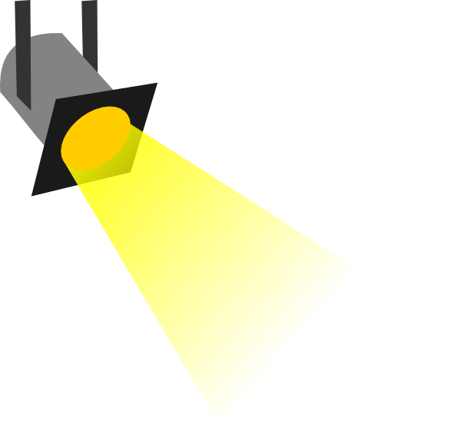

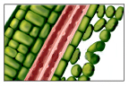
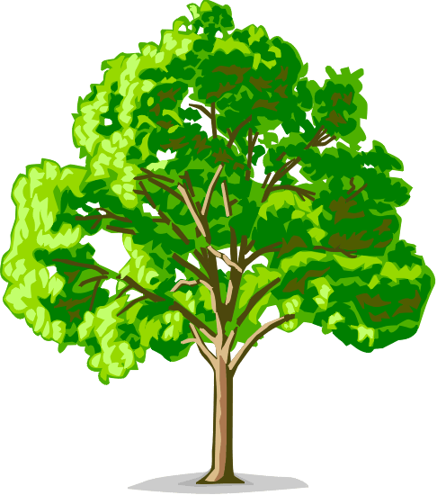
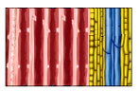
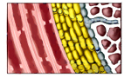
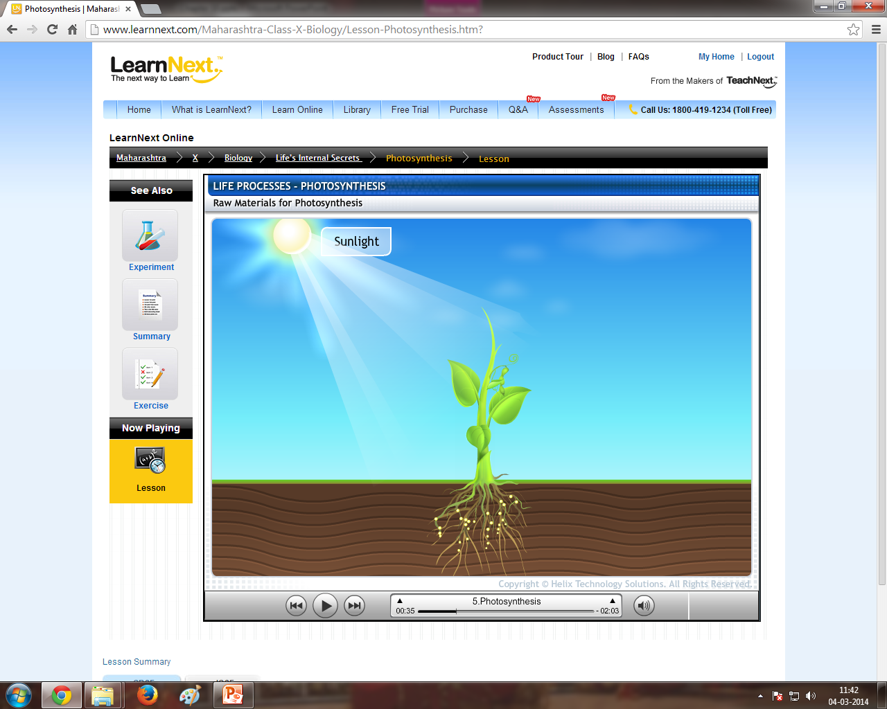
Transpiration Pull
The loss of water in the form of water vapour from the aerial parts of the plants, like leaves, is known as transpiration.
This leads to decrease in water potential of the epidermal cells.
This again creates a suction pull, which pulls water from the xylem of stem.
Because of this, the roots absorb more water.
This creates a suction pull which pulls the water from the xylem of leaves.
This pull is called as Transpiration pull.
And then again pulls water from the xylem of roots.
First water will evaporate from the epidermal cells.
It helps in transport of water and minerals in tall plants during day when the stomata are open.
Sunlight
Epidermal cells
Xylem (in leaves)
Xylem (in stem)
Xylem (in root)

Slide 4
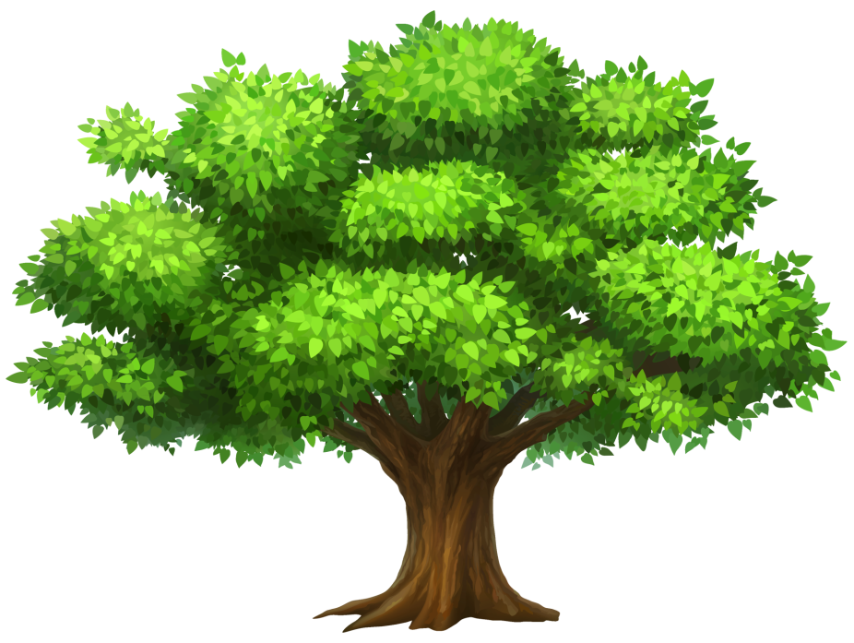


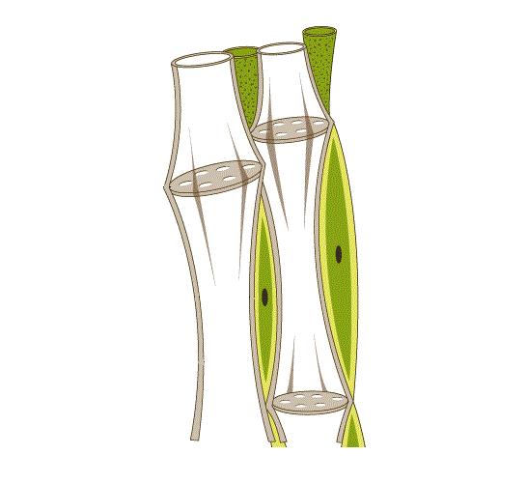

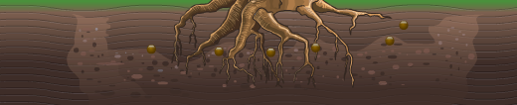
This process is known as
translocation
Besides amino acids, excess food is stored in storage organs
Food manufactured in the cells of the leaves is transported to each cell of the plant.
This is done by phloem in both upward and downward direction.
Food
S
Fruits
S
S
S
Seeds
Stem
Roots
Phloem

Slide 5

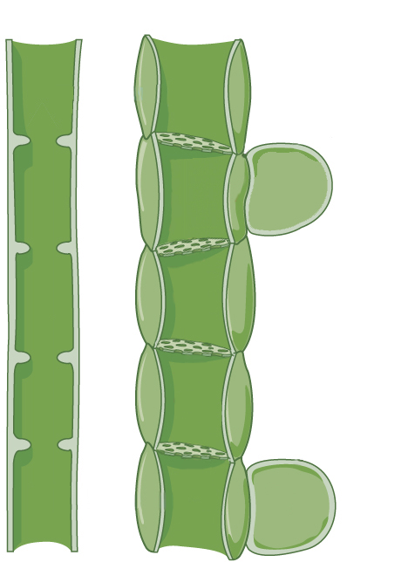


Food material like sucrose, is tranferred to phloem.
This pressure moves the food materials to the adjacent cells with low pressure.
This requires energy in the form of ATP.
Xylem
Phloem
This results in movement of water into the cells due to osmosis.
This allows the phloem to move materials according to the plant’s needs.
In the flowering season, sugar stored in the roots or stem is translocated to the buds for growing them into flowers.
This results in increase in pressure in the cells.
Leaf cell
Sucrose
Water
Root cell

Slide 6
Thank You

